Slide 1
Approximating solutions to systems of 1st-order initial-value problems

Slide 2
Introduction
In this topic, we will
Give a description of systems of 1st-order initial-value problems (ivps)
Discuss their solutions, if they can be found
Describe how operations translate to vector-space operations of vector addition and scalar multiplication
Look at converting our 1st-order solvers to solving systems of 1st-order ivps
Go over some examples

Slide 3
Systems of initial-value problems
Suppose we have a system of two 1st-order ivps
This has a unique solution:
Problem: this system has no known solution:

Slide 4
Systems of initial-value problems
Here is another such problem:

Slide 5
Systems of initial-value problems
Here is another problem that began a revolution in mathematics:
This is a simplified model of fluid convection, including:
The rate of convective motion
The temperature difference between rising and falling fluid parcels
The deviation of the temperature profile from a linear state

Slide 6
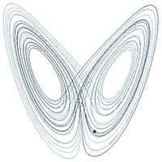
The Lorenz equations
This second equation is responsible for the term the butterfly effect
Dan Quinn via Wikipedia

Slide 7
Vector-valued functions of a real variable
We would like to approximate solutions to such systems
What approach do we use?
Let’s create a vector-valued function:
The derivative is as follows:

Slide 8
Vector-valued functions of a real variable
We can define such a function:
In this case, we have

Slide 9
Vector-valued functions of a real variable
A 3-dimensional vector-valued function of a real variable could represent:
The x, y and z coordinates of a drone at time t
The voltages at three nodes in a circuit at time t
The temperature readings from three sensors at time t
You could have fifty sensors, resulting in a 50-dimensional vector-valued function of a real variable
In each case, the derivative gives you the instantaneous rate-of-change of that vector-valued function
E.g., how fast the drone is moving north, west and vertically up

Slide 10
Vector-valued functions of a real variable
For example, you may have a drone flying in a figure eight over an area:
The direction of travel is given by:
The speed is given by
The speed varies between 5 m/s and 31 m/s

Slide 11
Approximating movement
Notice that if we have a position vector u and velocity vector v,
Then assuming the velocity is constant, we can estimate the position one time step into the future

Slide 12
Systems of 1st-order initial-value problems
Now, can’t we do the same with differential equations?

Slide 13
Systems of 1st-order initial-value problems
Now, can’t we do the same with differential equations?

Slide 14
Systems of 1st-order initial-value problems
Similarly, this system of three initial-value problems can b

Slide 15
Euler’s method
Let’s see how this works with Euler’s method:
Thus, we use

Slide 16
Heun’s method
Let’s see how this works with Heun’s method:

Slide 17
4th-order Runge-Kutta method
Let’s see how this works with the 4th-order Runge-Kutta method:

Slide 18
Implementation
Recall our implementation of Euler’s method:
std::tuple<double *, double *, double *>
euler( double f( double t, double y ),
std::pair<double, double> t_rng, double y0, unsigned int n ) {
double h{ (t_rng.second - t_rng.first)/n };
double *ts{ new double[n + 1] };
double *ys{ new double[n + 1] };
double *dys{ new double[n + 1] };
ts[0] = t_rng.first;
ys[0] = y0;
dys[0] = f( ts[0], ys[0] );
for ( unsigned int k{0}; k < n; ++k ) {
ts[k + 1] = ts[0] + h*(k + 1);
ys[k + 1] = ys[k] + h*dys[k];
dys[k + 1] = f( ts[k + 1], ys[k + 1] );
}
return std::make_tuple( ts, ys, dys );
}

Slide 19
Implementation
Let’s update it for vector-valued functions:
template <unsigned int N>
std::tuple<double *, vec<N> *, vec<N> *>
euler( vec<N> f( double t, vec<N> y ),
std::pair<double, double> t_rng, vec<N> y0, unsigned int n ) {
double h{ (t_rng.second - t_rng.first)/n };
double *ts{ new double[n + 1] };
vec<N> *ys{ new vec<N>[n + 1] };
vec<N> *dys{ new vec<N>[n + 1] };
ts[0] = t_rng.first;
ys[0] = y0;
dys[0] = f( ts[0], ys[0] );
for ( unsigned int k{0}; k < n; ++k ) {
ts[k + 1] = ts[0] + h*(k + 1);
ys[k + 1] = ys[k] + h*dys[k];
dys[k + 1] = f( ts[k + 1], ys[k + 1] );
}
return std::make_tuple( ts, ys, dys );
}

Slide 20
Implementation
All of this worked because for our vector class:
We defined all possible arithmetic operators on pairs of vectors
We also defined all possible arithmetic operators for scalar multiplication
We can make similar changes to the adaptive algorithms:
Only one additional trivial change is required for the adaptive algorithms:
We must compare two vectors with the norm:
double a{ eps_abs*h/(2.0*norm( y - z )) };
double a{ std::pow( eps_abs*h/(2.0*norm( y - z )), 0.25 ) };

Slide 21
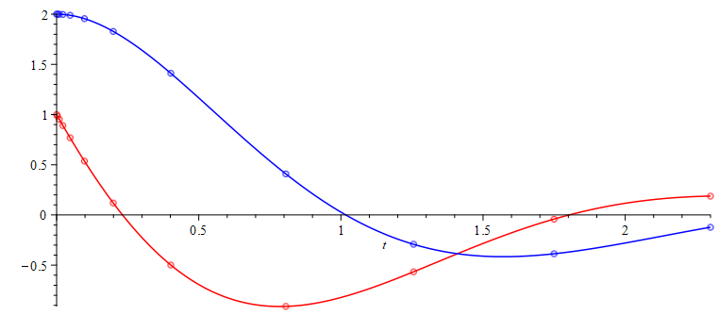
Implementation
Recall our problem and solution:

Slide 22
Implementation
The greatest issue is writing down the functions
vec<2> f( double t, vec<2> u ) {
return vec<2>{ -t*u[0] - 2.0*u[1],
-u[1] + 2.0*u[0] };
}
vec<2>{ 1.0, 2.0 }

Slide 23
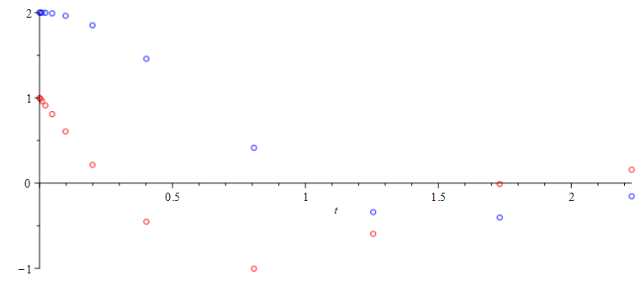
Implementation
Recall that this last problem did not have a closed-form solution, however, we can still approximate it

Slide 24
Implementation
The greatest issue is writing down the functions
vec<3> f( double t, vec<3> u ) {
return vec<3>{ 10.0*(u(1) - u(0)),
u(0)*(28.0 - u(2)) - u(1),
u(0)*u(1) - 8.0/3.0*u(2) };
}
vec<3>{ 1.0, 1.0, 1.0 }

Slide 25
Implementation
Let’s go the opposite direction:
vec<3> f( double t, vec<3> u ) {
return vec<3>{ -u(0) - u(1)*u(2) + t*t,
-u(1)*u(2) + 2.5*t,
-u(2) - u(0) + sin(t) };
}

Slide 26
Summary
Following this topic, you now
Have a deeper appreciation for systems of initial-value problems
Understand a system of initial-value problems can be converted to vector form
Know that this requires essentially no changes to the solvers
All of the arithmetic seamlessly translates to vector addition or scalar multiplication
Have an idea how to formulate such problems

Slide 27
References
[1] https://en.wikipedia.org/wiki/Initial_value_problem

Slide 28
Acknowledgments
Zizhou Wang for detecting an error in the indexing on Slide 23.

Slide 29



Colophon
These slides were prepared using the Cambria typeface. Mathematical equations use Times New Roman, and source code is presented using Consolas. Mathematical equations are prepared in MathType by Design Science, Inc.
Examples may be formulated and checked using Maple by Maplesoft, Inc.
The photographs of flowers and a monarch butter appearing on the title slide and accenting the top of each other slide were taken at the Royal Botanical Gardens in October of 2017 by Douglas Wilhelm Harder. Please see
https://www.rbg.ca/
for more information.

Slide 30
Disclaimer
These slides are provided for the ece 204 Numerical methods course taught at the University of Waterloo. The material in it reflects the author’s best judgment in light of the information available to them at the time of preparation. Any reliance on these course slides by any party for any other purpose are the responsibility of such parties. The authors accept no responsibility for damages, if any, suffered by any party as a result of decisions made or actions based on these course slides for any other purpose than that for which it was intended.

